Slide 1
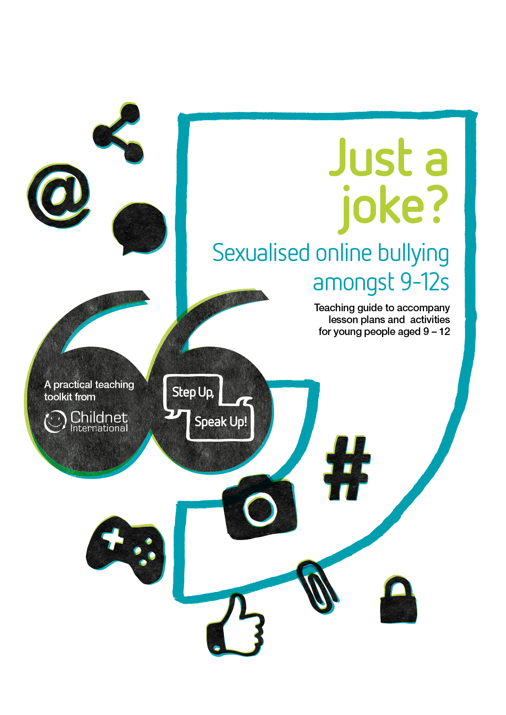
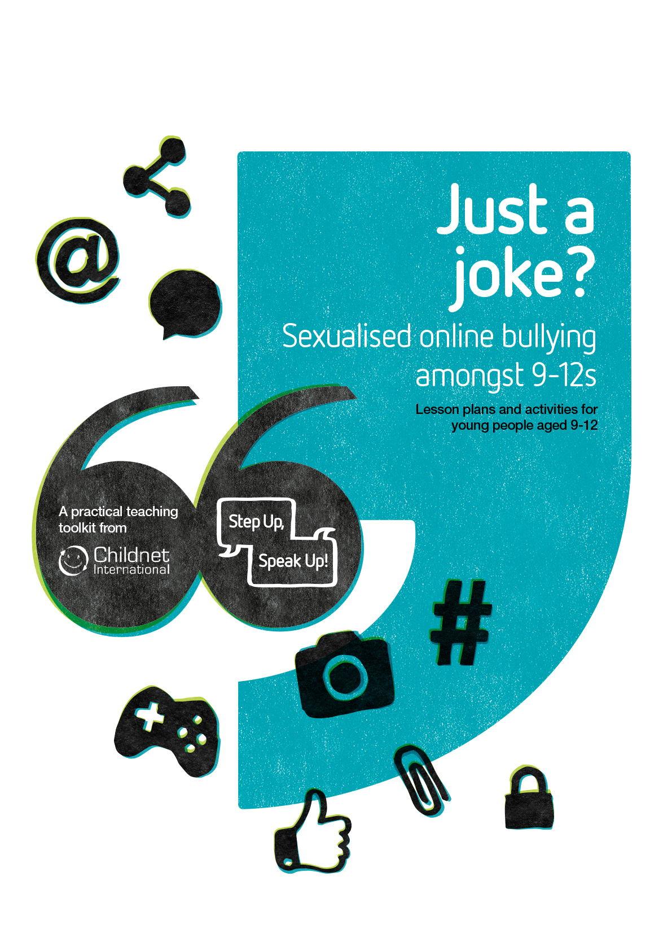
Educators notes
This quiz accompanies the ‘Just a Joke? Sexualised online bullying amongst 9-12s’ toolkit. It is designed as a summary activity to the lessons and quick activities in the toolkit.
Before delivering this activity:
Review the Teaching Guide for information about the topic and further advice on how to deliver these activities.
Refresh your knowledge of your school’s antibullying policy.
Refresh your knowledge of your school’s reporting and safeguarding procedures.
Work with your pupils to agree on a set of ground rules. See Lesson #1. Display these somewhere visible.
Before delivering this activity or giving pupils access to it:
You could delete or hide this slide.
Put the Powerpoint in Slide Show mode (click the projector screen image in bottom right corner). As you or your pupils click through, the correct answers will be revealed on screen.
Remind pupils to make a note of how many they guess correctly.

Slide 2














Just a
joke?
Quiz for young people aged 9-12

Slide 3

Test your
knowledge!
Now you’ve learnt all about cyberbullying that targets people’s gender, bodies or appearance, test your knowledge to see if you can give some expert advice.
Before your start…
…make sure you are using Slide Show mode –
click this icon in the bottom right corner.
And remember…
…make a note of how many you guess correctly to keep track of your score!

Slide 4


What advice would you give Jaz?
A
“Katy’s right! Post the photo and emoji – everyone will think it’s funny!”
B
“Post it but without the emoji. Everyone can else can decide what they see.”
1.
Jaz takes a photo of two friends hugging. Because of the angle, it looks like they could be kissing. Jaz’s friend, Katy, suggests Jaz post it in a group chat with the kissing emoji.
C
“You should message the people in the photo first to see if they mind. If they don’t like it, you should delete it.”
D
“Katy loves causing drama – you should delete the photo straight away.”

Slide 5

Online challenges can be fun but think carefully about whether they are putting anyone at risk or making others feel uncomfortable. Not everyone finds the same things funny and if there’s any chance you’re going to upset someone, it’s best not to join in.
What advice would you give Joe?
A
“You should show the screenshot to the girls so they know their private messages have been leaked!”
2.
Joe sees a screenshot of some private messages between two girls at his school. It is clear from the messages that the two girls are close friends and now everyone is sharing the screenshot and saying they are a couple.
B
“Report the screenshots using the report tool and show them to a teacher.”
C
“You should share the screenshot with a positive message of support – that’ll make the girls feel better.”
D
“You should reply publicly to people’s comments and let them know that they’re being unkind.”

Slide 6
Online challenges can be fun but think carefully about whether they are putting anyone at risk or making others feel uncomfortable. Not everyone finds the same things funny and if there’s any chance you’re going to upset someone, it’s best not to join in.
What could they do to help?
A
Screenshot the messages as evidence of what is happening.
B
Report the person being mean using the in-game reporting tool.
3.
Rahul and Mo are playing an online game with a group of friends from their athletics club. They see another friend using offensive language and deliberately being mean to the girls who are on the team too.
C
Send a private message of support to the players being targeted.
D
All of the above.

Slide 7
Online challenges can be fun but think carefully about whether they are putting anyone at risk or making others feel uncomfortable. Not everyone finds the same things funny and if there’s any chance you’re going to upset someone, it’s best not to join in.
What advice should Tara give them?
A
“Go for it – it’ll be such a laugh and I’m sure they’ll see the funny side!”
B
“We should only post it on our group chat so nobody else sees it – don’t want to get in trouble!”
4.
An online challenge which involves standing behind people and doing a rude dance without them realising has gone viral. Lots of Tara’s friends are sharing the videos. They decide to make some of their own and want to dance behind a pupil who none of them are friends with.
C
“Let’s film it with lots of people so we’re not just targeting one person!”
D
“Some people might not like being part of these videos – if there’s a risk we’re going to upset someone then we shouldn’t do it all.”

Slide 8
Online challenges can be fun but think carefully about whether they are putting anyone at risk or making others feel uncomfortable. Not everyone finds the same things funny and if there’s any chance you’re going to upset someone, it’s best not to join in.
What advice would you give Ivan?
A
“Show the message to an adult you trust – it’s not okay for someone to do that.”
B
“Laugh with everyone else – send a laughing emoji to show that you get the joke.”
5.
During a science lesson Ivan’s teacher shows a picture of a naked body and asks the class to label the body parts. One of Ivan’s classmates takes a photo of it and edits Ivan’s face on to it.
C
“Ignore it – bullies like that just want attention anyway, so don’t give them it.”
D
“Find a different naked photo online and send another edited picture back so they know how it feels.”

Slide 9
Online challenges can be fun but think carefully about whether they are putting anyone at risk or making others feel uncomfortable. Not everyone finds the same things funny and if there’s any chance you’re going to upset someone, it’s best not to join in.
What should Malik do?
A
Report the unkind comments online and tell an adult about them offline.
B
Be honest - send Archie a message telling them that the photos don’t look very good and they should take them down.
6.
Malik’s friend Archie posts some photos online from a recent holiday. Some people post comments about how ‘fat’ Archie looks, and Malik secretly agrees with them.
C
Comment “It doesn’t matter what you look like – it’s what’s on the inside that counts.”
D
Ignore it all – Malik shouldn’t hurt Archie but also shouldn’t lie.

Slide 10
Online challenges can be fun but think carefully about whether they are putting anyone at risk or making others feel uncomfortable. Not everyone finds the same things funny and if there’s any chance you’re going to upset someone, it’s best not to join in.
What should Jaden do?
A
Do nothing – it was an accident and his friends will get in trouble if he tells someone.
7.
Jaden is pranked by his friends during a live video. They try to pull his trousers down but his underwear starts to come down too. As soon as they realise what has happened they help cover Jaden up, but some people watching still saw and now he’s getting teased online about what happened.
B
Get revenge on his mates by pranking them back.
C
Tell an adult what has happened and show them the messages.
D
Go live again and laugh it off so people can see that he’s not affected.

Slide 11
Online challenges can be fun but think carefully about whether they are putting anyone at risk or making others feel uncomfortable. Not everyone finds the same things funny and if there’s any chance you’re going to upset someone, it’s best not to join in.
What advice would you give Simran?
A
“Send him a photo – he’ll stop bothering you once he’s got what he wants.”
B
“Just block him – then he can’t contact you again.”
8.
Simran has been messaging a boy from another school online who has started asking for pictures of her. She sends him a selfie, but he says it’s not enough. He calls her a rude word and threatens to tell her parents that she’s been messaging him, if she doesn’t send a photo.
C
“Find a random picture of someone else online and pretend it’s you.”
D
“Talk to your parents – or a teacher in school. They can help!”

Slide 12
Online challenges can be fun but think carefully about whether they are putting anyone at risk or making others feel uncomfortable. Not everyone finds the same things funny and if there’s any chance you’re going to upset someone, it’s best not to join in.
What should Amara do?
A
Ask to borrow her friend’s phone then delete the photo when she’s not looking.
B
Ask her friend to crop the photo so her face isn’t visible and people won’t know it’s her.
9.
Amara is at the park with some friends when one of them takes a picture of her doing a handstand. All her friends think the photo is great – the handstand looks perfect! But Amara is really embarrassed because her underwear is on show.
C
Explain why she doesn’t like photo and ask her friend to delete it.
D
Be proud of her gymnastic skills and stop worrying so much.

Slide 13
Online challenges can be fun but think carefully about whether they are putting anyone at risk or making others feel uncomfortable. Not everyone finds the same things funny and if there’s any chance you’re going to upset someone, it’s best not to join in.
What should Shani do?
A
Tell an adult about what’s happening so they can get the account taken down.
10.
Shani doesn’t have a mobile phone but finds out from some friends at school that someone has set up an online account pretending to be her. The account has been sharing links to pictures and videos that show older people without clothes on. People at school are blaming Shani.
B
Use a friend’s account to investigate and work out who started the fake account.
C
Get a friend to report the fake account then create her own so it doesn’t happen again.
D
Spread the word in school that it isn’t her and get everyone to remove the account from their friend’s list.

Slide 14


How did you do?
0-3
Correct answers
Good try but there’s still more you can learn about helping to stop cyberbullying that targets people’s gender, bodies or appearances. Remember, if something happening online makes you or your friends feel uncomfortable or unsure, ask an adult for help.
4-7
Correct answers
Great job. You’re starting to understand how to support others who are being targeted for their gender, bodies or appearance online. Why not go back and look at the questions you didn’t get right? Do you understand why the advice you choose wasn’t the most helpful? Check with an adult if you’re unsure.
8-10
Correct answers
Fantastic work! You’re an expert in helping to support others getting bullied online for who they are. Why not teach your friends and family the importance of respecting people’s gender, bodies and appearances online and help them to be safe and positive internet users too. Well done!

Slide 15






II
Digital Exploitation and Sexual Harassment Among Minors in Europe
This quiz was funded by the European Union’s Rights, Equality and Citizenship Programme (REC 2014-2020). The content of this quiz represents only the views of the authors and is their sole responsibility. The European Commission does not accept any responsibility for use that may be made of the information it contains.'

