Slide 1
ANTI-BULLYING WEEK 2023

Slide 2
“
The repetitive, intentional hurting of one person or group by another person or group, where the relationship involves an imbalance of power. Bullying can be physical, verbal or psychological.
It can happen face to face or online.
“

Slide 3
Anti-Bullying Week 2023
Make A Noise About Bullying
Too often, we are silent when we see bullying take place, silent about the hurt bullying causes, and silent when we hear bullying dismissed as ‘just banter’.
Together, we can make a difference and take a stand against bullying.
From the playground to Parliament, and from our phones to our homes, let’s make a noise about bullying.
It doesn't have to be this way.
Of course, we won’t like everyone, and we don’t always agree, but we can choose respect and unity.
This Anti-Bullying Week let’s come together to have discussions about what bullying means to us, how banter can turn into something more hurtful, and what we can do to stop bullying.

Slide 4
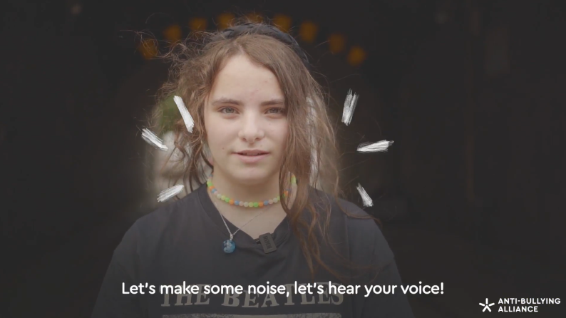
https://youtu.be/0vWCg2ElEYY

Slide 5
“
What hurts the victim most is not the cruelty of the oppressor, but the silence of the bystander.
“
Elie Wiesel
Holocaust survivor & human rights champion

Slide 6
?
WHAT IS BANTER?

Slide 7
BANTER IS…
“
Banter is the harmless exchange of social interaction between friends which involves teasing or mocking one another, either on a one-to-one basis or more commonly on a friendship group basis.
“

Slide 8
What can you do now?
Speak up
Let’s make a noise about bullying!
If you see something, say something! Say its not ok, say stop! As mentioned in the video, it can simply be asking questions.
Be supportive
When you see someone being bullied, let them know they aren’t alone. Ask if they’re ok, ask if they’d like your help with dealing with it, or simply say hi!
Tell a trusted adult
It’s always important to let an adult know what’s going on. Tell them what you’ve seen or heard. They’re here to help!

Slide 9
Who can you speak to at school?
Staff name here
Staff name here
Staff name here

