Slide 1


Supporting families and young people
affected by bullying
© Copyright Family Lives 2014

Slide 2

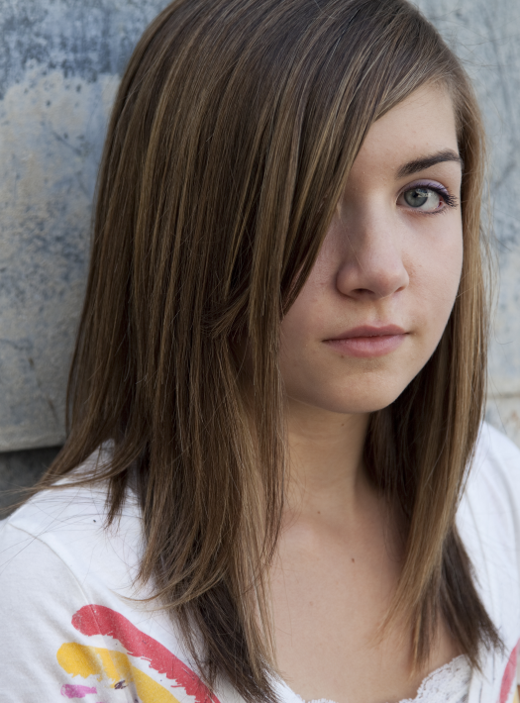
Bullying facts/stats?
69% of young people experience bullying before their 18th birthday.
60% of people bullied because of appearance
30% said that bullying has had a huge impact on their social lives
38% said that bullying has had a
huge impact on their self esteem
25% young people have had suicidal thoughts because of bullying
www.bullying.co.uk
© Copyright Family Lives 2014
Notes:
^{References}
Ditch the label Annual bullying survey 2013 - http://www.ditchthelabel.org/downloads/Annual-Bullying-Survey-2013b.pdf

Slide 3

Types of bullying
Physical (when someone pushes you, hits you or harms you in any way physically)
Name calling (bullied by name calling regularly and it is hurtful)
Social (leaving out, making plans and excluding others, etc.)
Cyberbullying (being bullied online, via mobile phone or on social networks)
Sexual (bullying includes unwanted sexual advances/comments, sexuality, spreading sexual rumours)
www.bullying.co.uk
© Copyright Family Lives 2014
Notes:
It can help to discuss the types of bullying and encourage the young people to think of examples that could be physical, name calling, social, cyberbullying and sexual. This can give them a greater understanding of the types of bullying. This could be a table exercise with one group tackling one type of bullying then class discussion and comparisons.

Slide 4
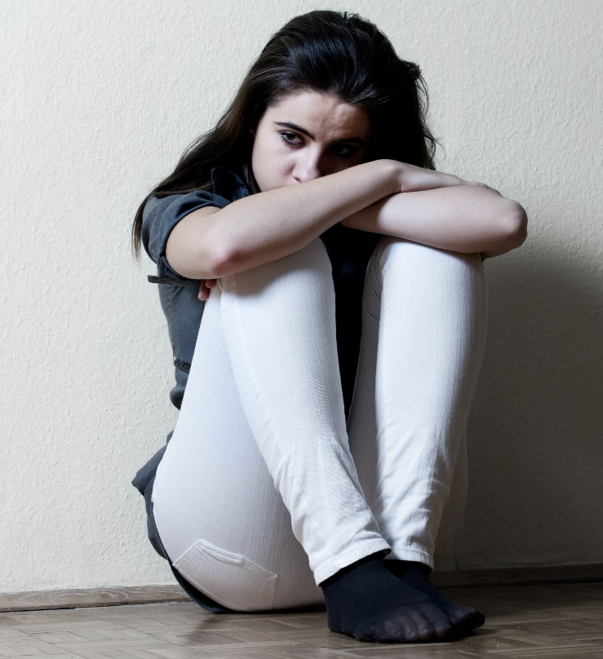
How bullying can make you feel
Depressed
Anxious
Isolated
Withdrawn
Suicidal
Humiliated
Low
Upset
Angry
Frustrated
Start to believe it
Blame themselves
www.bullying.co.uk
© Copyright Family Lives 2014
Notes:
Someone who is being bullied in this way may feel lots of different emotions. Often a young person might act like they are ok on the outside but inside they may be feeling very low. They might not want to show how they are really feeling in case others think they are making a big deal out of nothing, or cannot take a joke and perhaps they are even worried it might get worse. They may also start to believe the verbal bullying and this will knock self-esteem. To understand how a person feels on the inside, it is important to try and see how they might be feeling if they are being called these names day in and day out. Many young people say to us that they often the feel some of the emotions above.

Slide 5
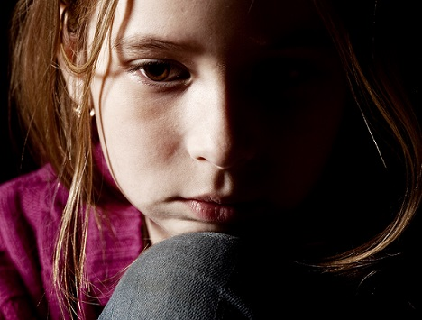
How might they react?
Self-harm
Feel depressed
Suicidal thoughts/attempts of suicide
Withdraw socially and stop going out
Avoid social media or messenger
Feel anxious about going to school
Be very angry and be aggressive
Bully others
Develop an eating disorder
Turn to drinking or taking drugs
www.bullying.co.uk
© Copyright Family Lives 2014
Notes:
A person might bottle up their emotions and try not to let it show to their friends or family. It can be hard for someone to feel all those things and try to keep it to themselves and often as a result their behaviour may change. They may show their feelings in other ways and know the signs to look out is really important. In extreme cases, a person may feel so low they may attempt to or actually take their life. This is sadly a reality for some families who have lost a loved one through bullying.

Slide 6

What about how bullying affects other areas of life?
Family life
School work
Relationships
Friendships
Socially
Emotional well-being
Future relationships
www.bullying.co.uk
© Copyright Family Lives 2014
Notes:
Bullying can and does affect people’s feelings and other areas of their lives. If you see someone being bullied then you may think they are just taking it well or not bothered, but inside how a person feels may not show on the outside. If it becomes regular, they may change their behaviour as a result of the bullying. It can also affect other areas of their life, including friendships, school work and family life. There has been cases where young people and their family have moved and made a new life elsewhere because of bullying.

Slide 7
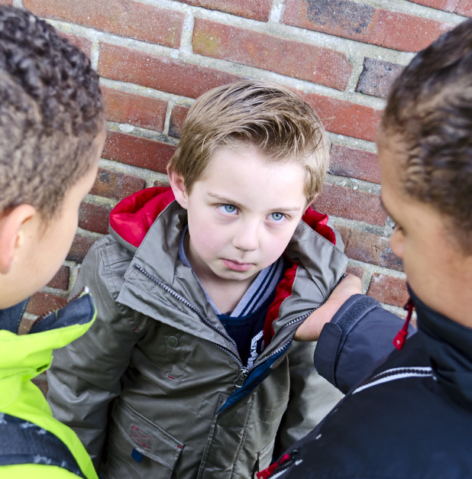

How to get bullying
to stop
Report the bullying to a teacher
Tell a parent or a family member
Be assertive not aggressive
Ignore it and walk away
Keep a diary of all incidents
www.bullying.co.uk
© Copyright Family Lives 2014
Notes:
Report the bullying to a teacher or someone at school you feel safe with. They may be able to take action and get the bullying to stop. If you are worried that it might make it worse, perhaps you can ask the teacher to just keep an eye on it as they then might see it themselves and take action.
Tell a parent or a family member. This can give you lots of strength and a parent or family member can help you to get the bullying to stop. They can also give you lots of emotional support. It is important to try and tell someone in your family what is going on so you are not bottling things up. Talking about what you are going through can give you courage to get it stopped.
Be assertive with the bully and say their name calling is boring or making them look stupid but not aggressive. However, it is important to ensure that this course of action doesn’t cause them to become aggressive or make the bullying worse. You may think a quiet chat with them when they are on their own might work, but if you do so, please take a friend with you for support.
Ignore it and walk away. Quite often the bully stops when they are no longer receiving attention or a reaction from the bullying. It is always difficult to try and ignore it especially when it is so upsetting or if it is constant but if they don’t get a reaction, it can stop.
Keep a diary – it is very important to keep a diary of times and dates of all incidents no matter what it is from name calling, physical, anything that is relevant.
It is really important to try and keep your cool in these situations even though the name calling bullying might be making you feel very angry. It is natural to feel this way but if you get aggressive and things turn nastier or physical then someone could get seriously injured or into trouble with the police. This is why it is important to get some help to get the bullying to stop.

Slide 8

True or false
You can spot a bully from the way they look and act?
Cyberbullying can only affect someone if they are online and have an account too
Bullying is a normal part of childhood and you should just ignore it
Bullying only happens in schools
Reporting a bully will make things worse
It is easy to spot the signs of bullying
It is not bullying if someone deletes the comment or post
www.bullying.co.uk
© Copyright Family Lives 2014
Notes:
Fact: There is no such thing as a way a bully looks or acts. There is no specific dress code or behaviour code. Online bullying…
Fact: This is not true, we often hear of pages and fake accounts being created without person’s permission or knowledge. This sort of cyberbullying is on the increase and just as serious as any other form of bullying.
Fact: Bullying is not "normal" or acceptable in any form and ignoring might not always make it stop. If you can, please confide in someone you trust such as a parent or teacher to help you get it stopped. Bullying can knock your self-esteem and confidence.
Fact: This is not the case at all, bullying can happen to anyone at any place. It may be out of school, at university or even college. It can happen when you are out with mates or on the way to or from school.
Fact: You may worry that reporting a bully might make the bullying escalate or they feel they are not believed. It is important to confide in someone you trust so that you can have some help in getting the necessary support to get this stopped.
Fact: It is not always easy to spot the signs of bullying as it is not always physical and obvious. Emotional, verbal and online bullying can often leave scars that people don’t see.
Fact: Regardless of hitting delete, once something is posted online is gets its own unique URL which means that it can stay on cyberspace even if you hit delete.

Slide 9
Bullying tasks
Ask the students whose birthday is between January and July to stand up and remain standing. Ask them to put their hands on their hand. Then ask them how they would feel if they were asked to stand throughout the whole lesson. Once they describe their feelings (awkward, vulnerable, etc.) you reiterate to them that this is how people feel when they are being bullied even if they don’t show it.
Give the students 2 pieces of paper and ask them to put one on the table and screw up the other one as tightly as they can. Once they have done this, ask them to unravel the screwed up piece of paper and try to straighten it out the best they can. Then ask the students to hold up the two pieces of paper and compare the differences. Then you can reiterate to them that no matter how much you try to straighten things out, the scars of bullying remain.
www.bullying.co.uk
© Copyright Family Lives 2014
Notes:
Both tasks can take about 5 – 10 mins each depending on size of class.
The aim of the first task is to show young people how bullying can make a person feel, exploring their emotional vulnerability, feeling awkward or targeted, etc. Encourage the young people to describe the emotions felt.
The second task is to show young people that no matter how much you try to fix it, apologise, etc. the scars of bullying often remain within a person and affects their life in the present and future with issues like trust, relationships, etc.

Slide 10

Interactive bullying video
© Copyright Family Lives 2014
Notes:
This interactive anti-bullying video created last year by Ambient Night Theatre in Birmingham with assistance from Benjamin France. It was created entirely by young volunteers. Throughout this video you will be asked to make a decision from the point of view of the bully, the victim or the friends. These choices will alter the story as you go. You can download our discussion pack with questions to ask students.

Slide 11
How we can help
Online chat on our website or email us at parentsupport@familylives.org.uk
Free helpline 0808 800 2222
Advice on our website www.bullying.co.uk
Twitter: @BullyingUK
Facebook: www.facebook.com/bullyinguk
^{Through life’s ups and downs,}
^{we’re with you, all the way}
© Copyright Family Lives 2014

