Slide 1


Slide 2
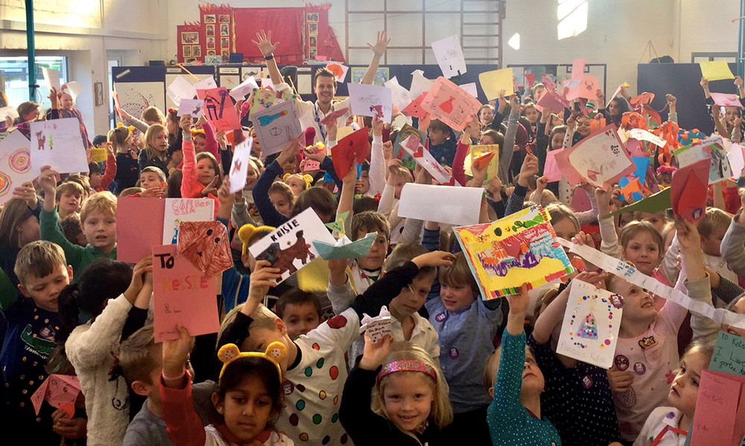




Today we are going to be thinking about how we can be kind to others.
Let’s look at some pictures of children showing kindness…

Slide 3
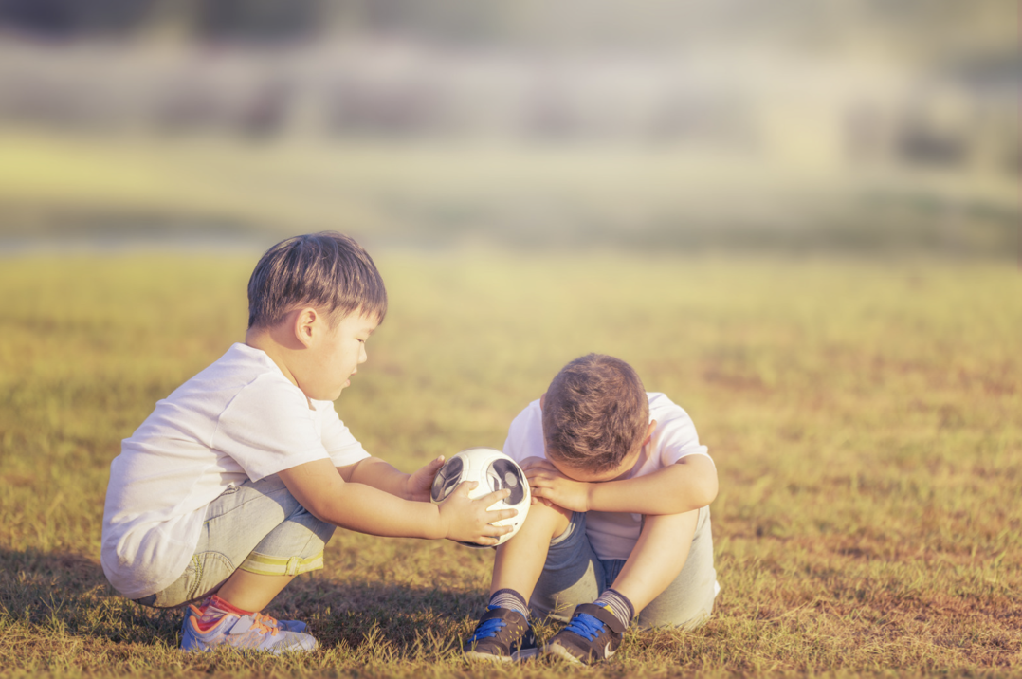
What can you see?

Slide 4
What can you see?
What do you think is happening in this picture?
Who is showing kindness?
What might have happened just before this picture was taken?
What might they be saying?
What do you think will happen next?

Slide 5
Talk about your picture with your partner!

Slide 6





Slide 7
What does kindness in school look like?
How do we show kindness in our classroom and in our school?

Slide 8
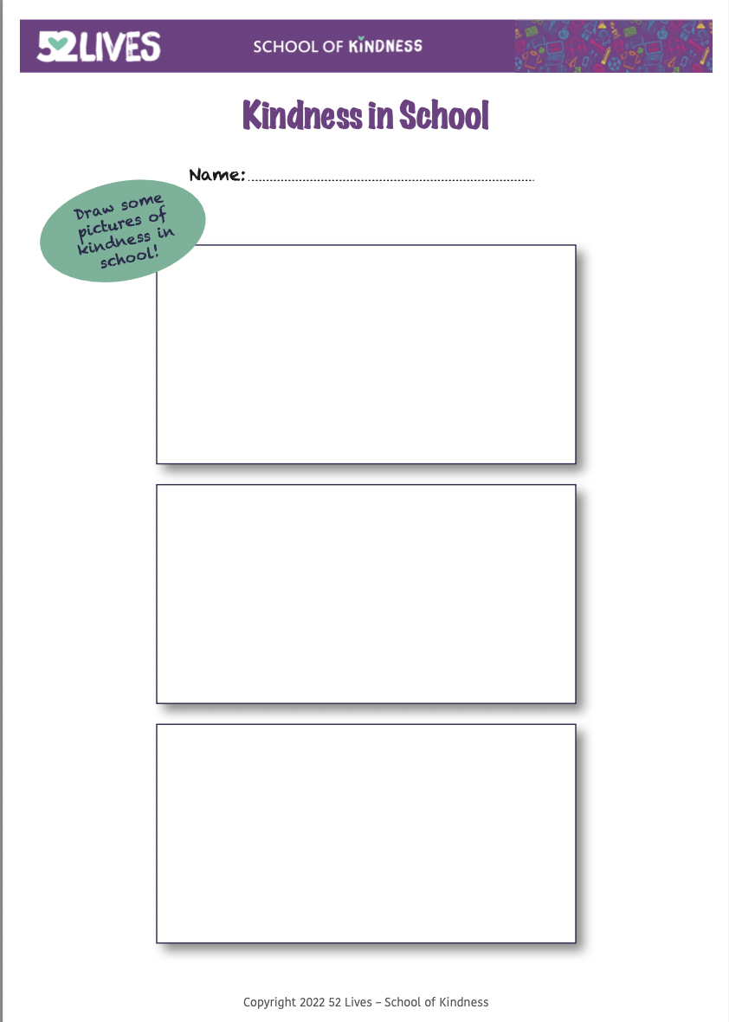

Slide 9
How do you feel when you do something kind?

Slide 10
How does it feel to be in a kind classroom?

Slide 11
We can all do our little bit every day to help create a kind classroom!

Slide 13
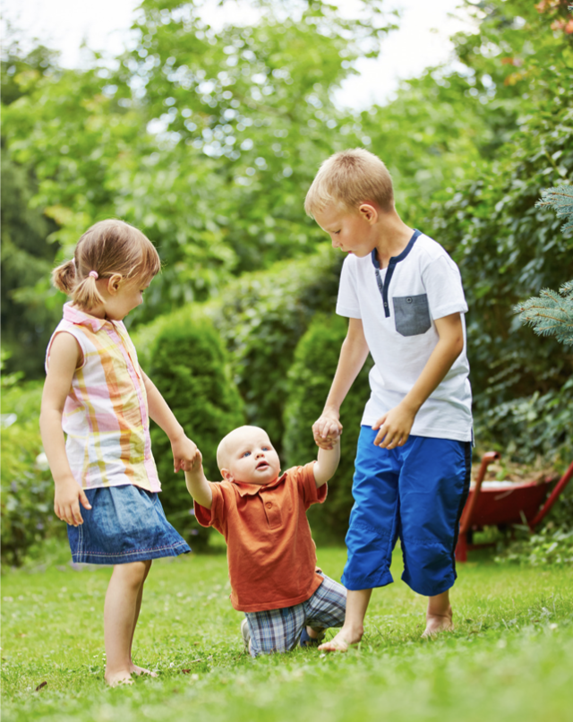

Slide 14
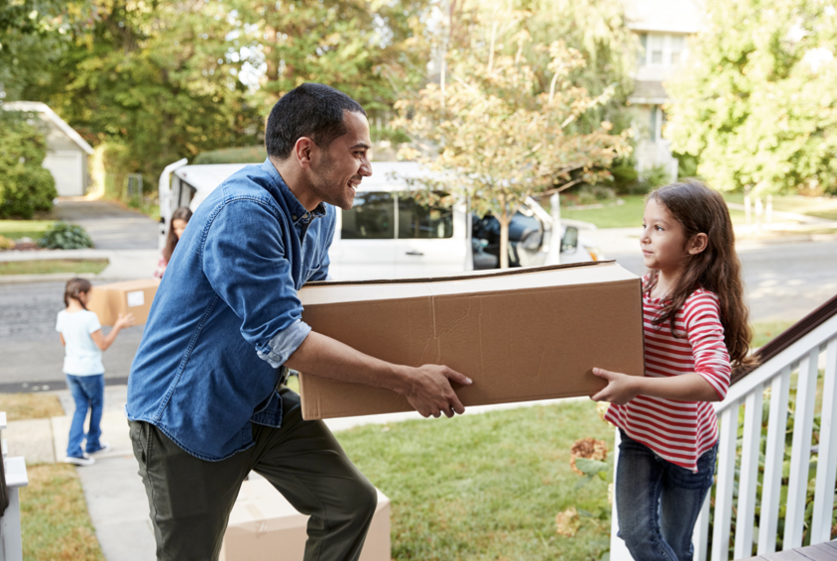

Slide 15
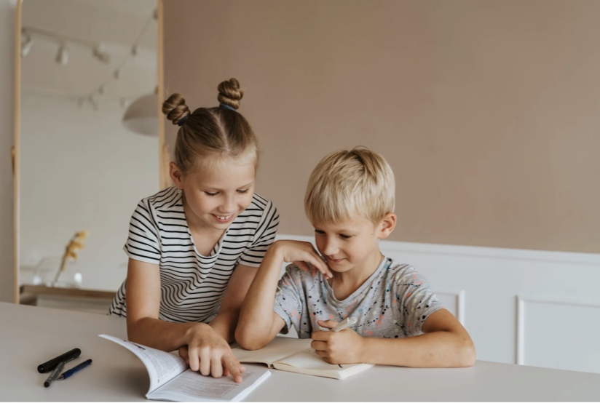

Slide 16
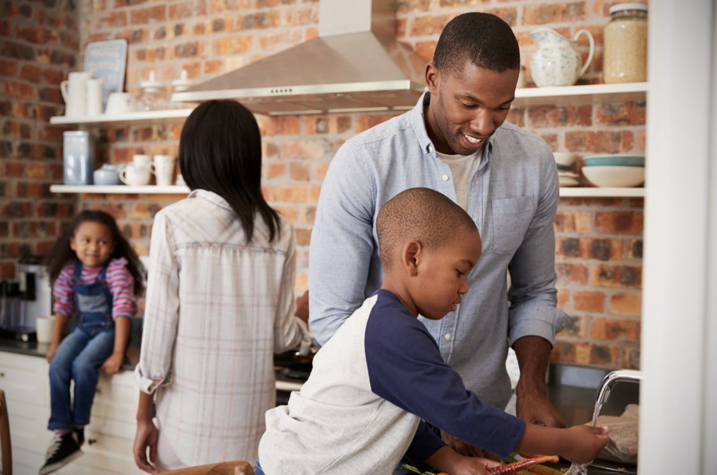

Slide 17
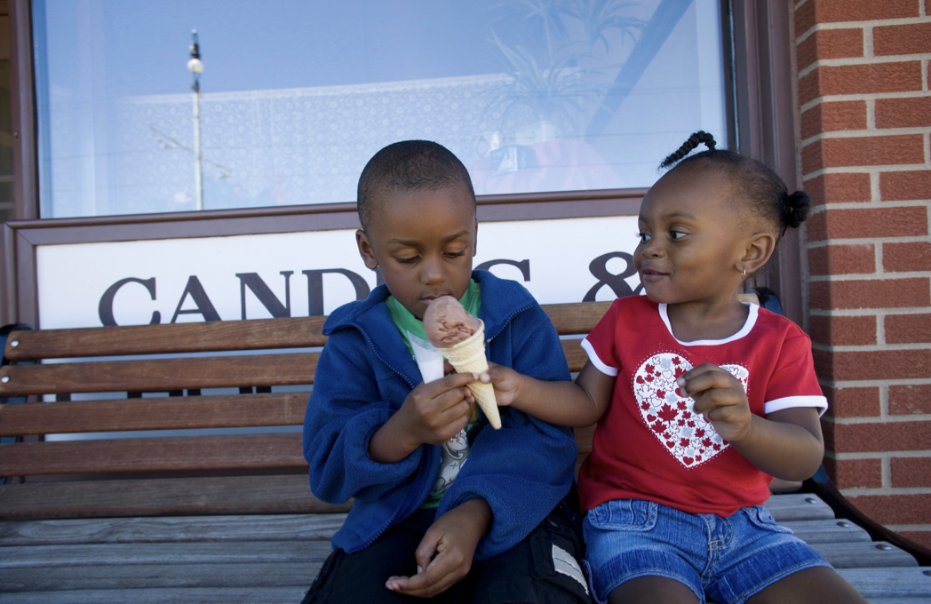

Slide 18
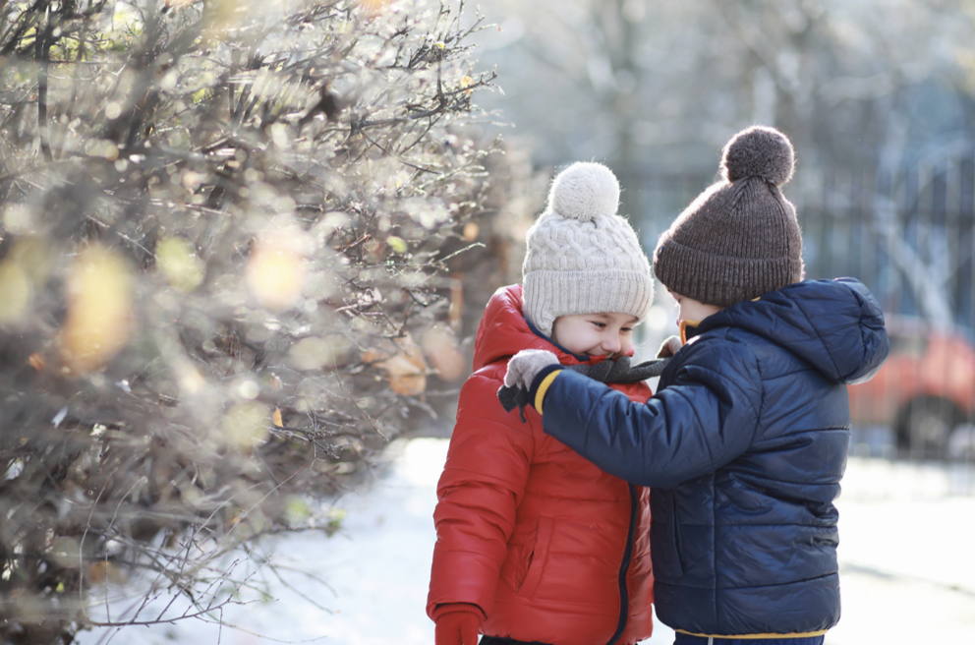

Slide 19
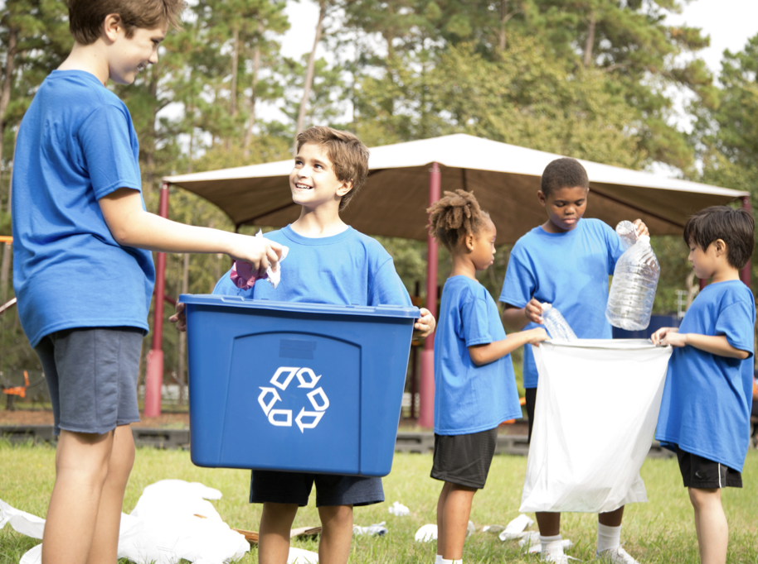

Slide 20
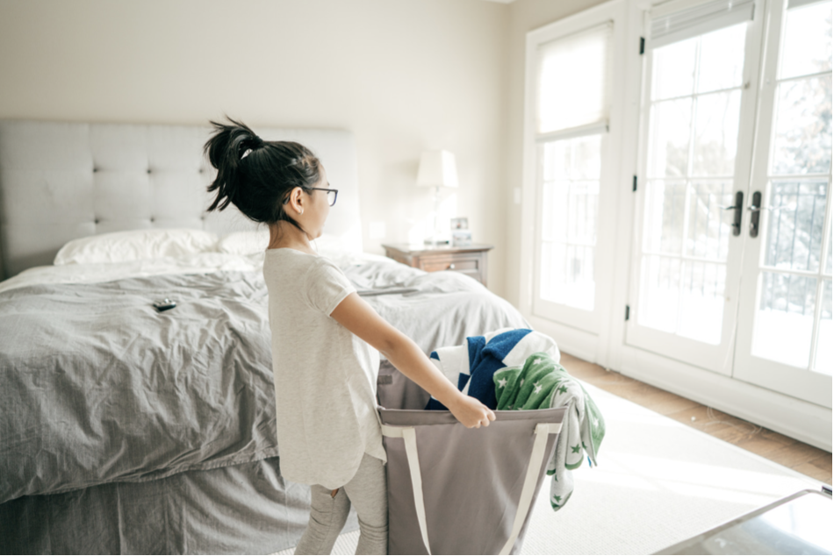

Slide 21
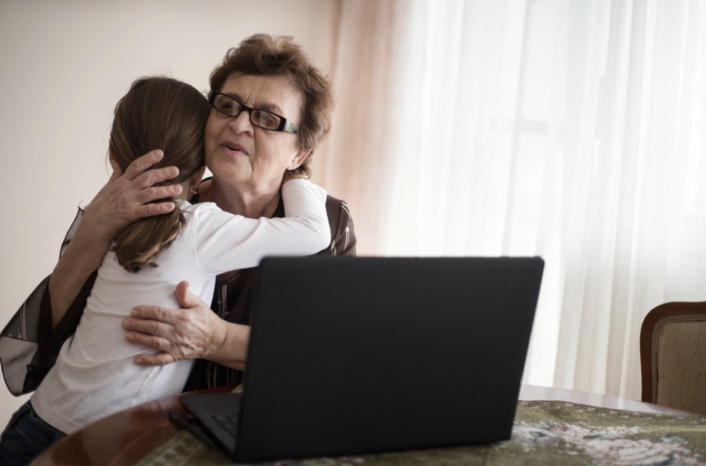

Slide 22
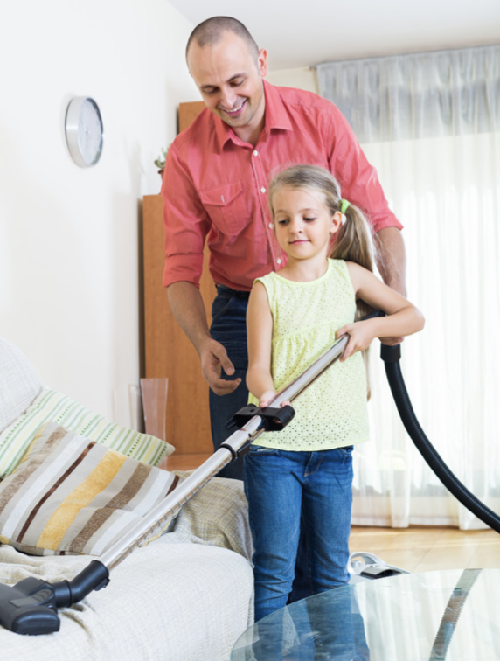

Slide 23
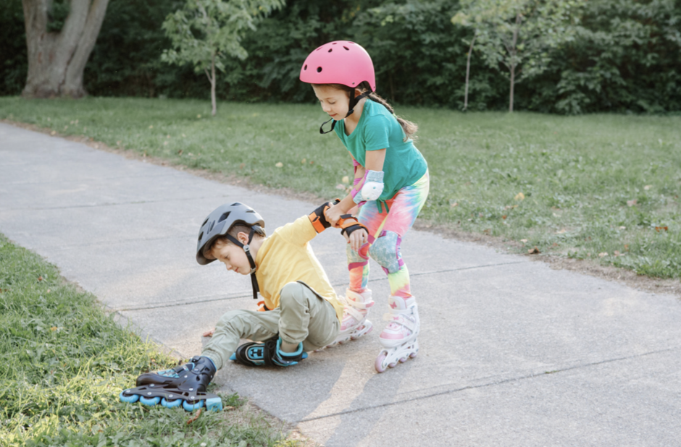

Slide 24
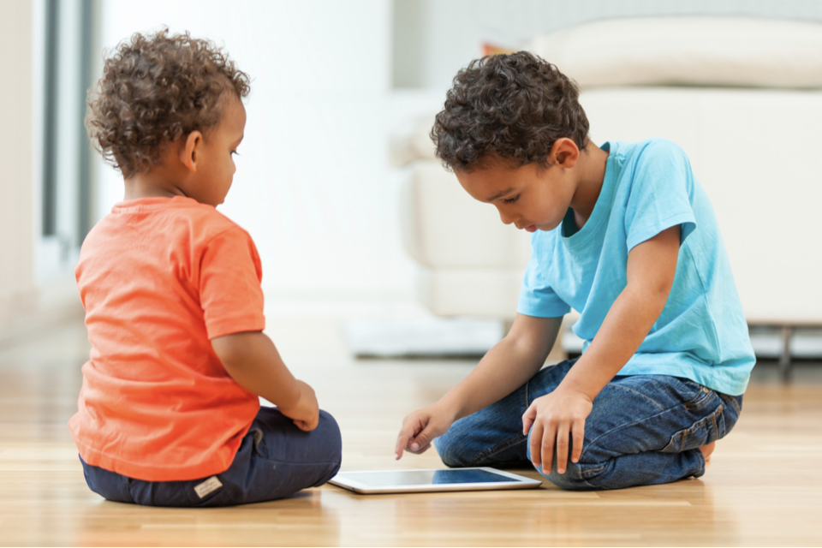

Slide 26
