Slide 1

Anti-Bullying Week 2014
Key Stage 1 - lesson activities
Created with Helen Lambie 2014
Notes:
Thank you for using the Lesson Plan for Anti-Bullying Week 2014 created by the Anti-Bullying Alliance.
This lesson plan is for Key Stage 2. Please adapt it as appropriate to your school.
This Anti-Bullying Week, the Anti-Bullying Alliance are calling on the school community to take action to stop the bullying of ALL children and young people – including those with disabilities – those research show are significantly more likely to experience bullying in schools and the wider community.
This lesson plans has the following learning outcomes:

Slide 2

What makes me ME?
Notes:
All children have a work sheet XXX – What makes me ME?
Ask the children to think about:
What they are good at (scroll)
What is important to them (speech bubble)
Their two favourite things (heart)
What they would like to be/do in the future (thought bubble)
Get the children to share these in pairs
Ask how different everyone’s answers are? This shows how we are all different and unique.

Slide 3

What if we were all the same?
Notes:
Animated slide
Ask pupils ‘What would the world be like if we were all the same’.
Possible answers: ‘boring’ / ‘not exciting’ / ‘not interesting’
Hope that young people start to realise that we should like the differences we all have as they make us us and they make us interesting.

Slide 4
We are ALL unique and different
Notes:
The outcome of this discussion should be that we are all unique and that we should celebrate our differences whatever they are!

Slide 5
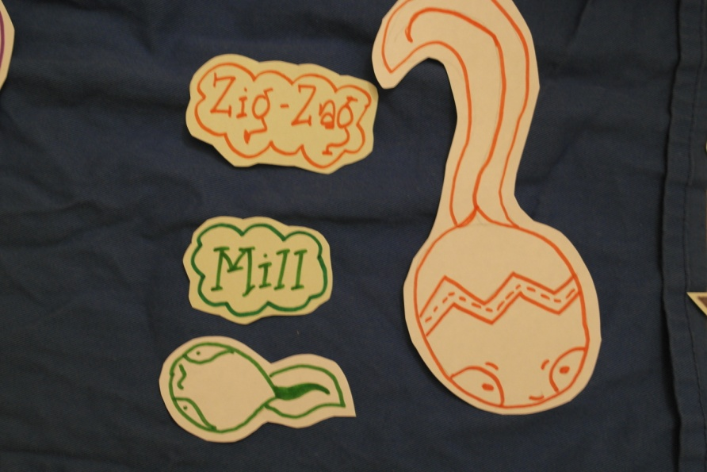
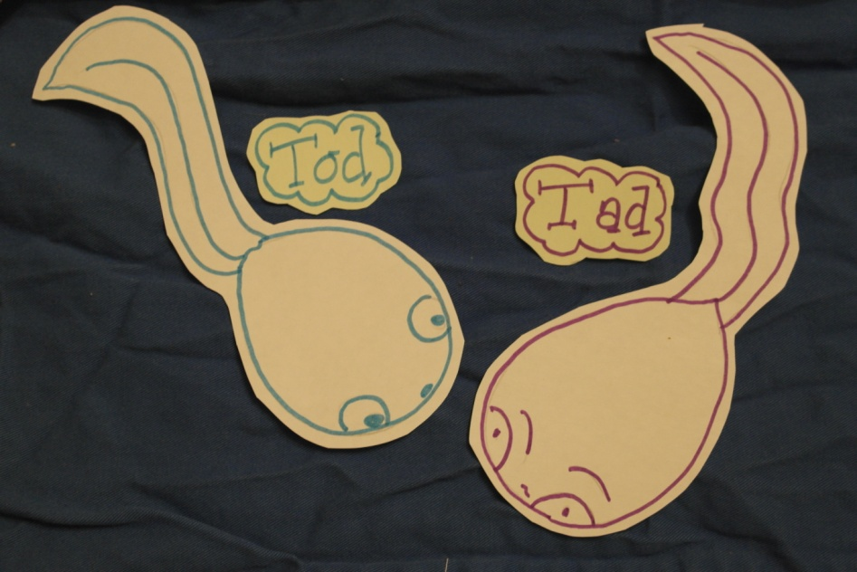
Mill’s Story
In a pond not far from here hatch some beautiful tadpoles. They were all different and all special.
One little tadpole was very different from the rest. Mill couldn’t swim as well as the rest and she was smaller than the rest.

Slide 6
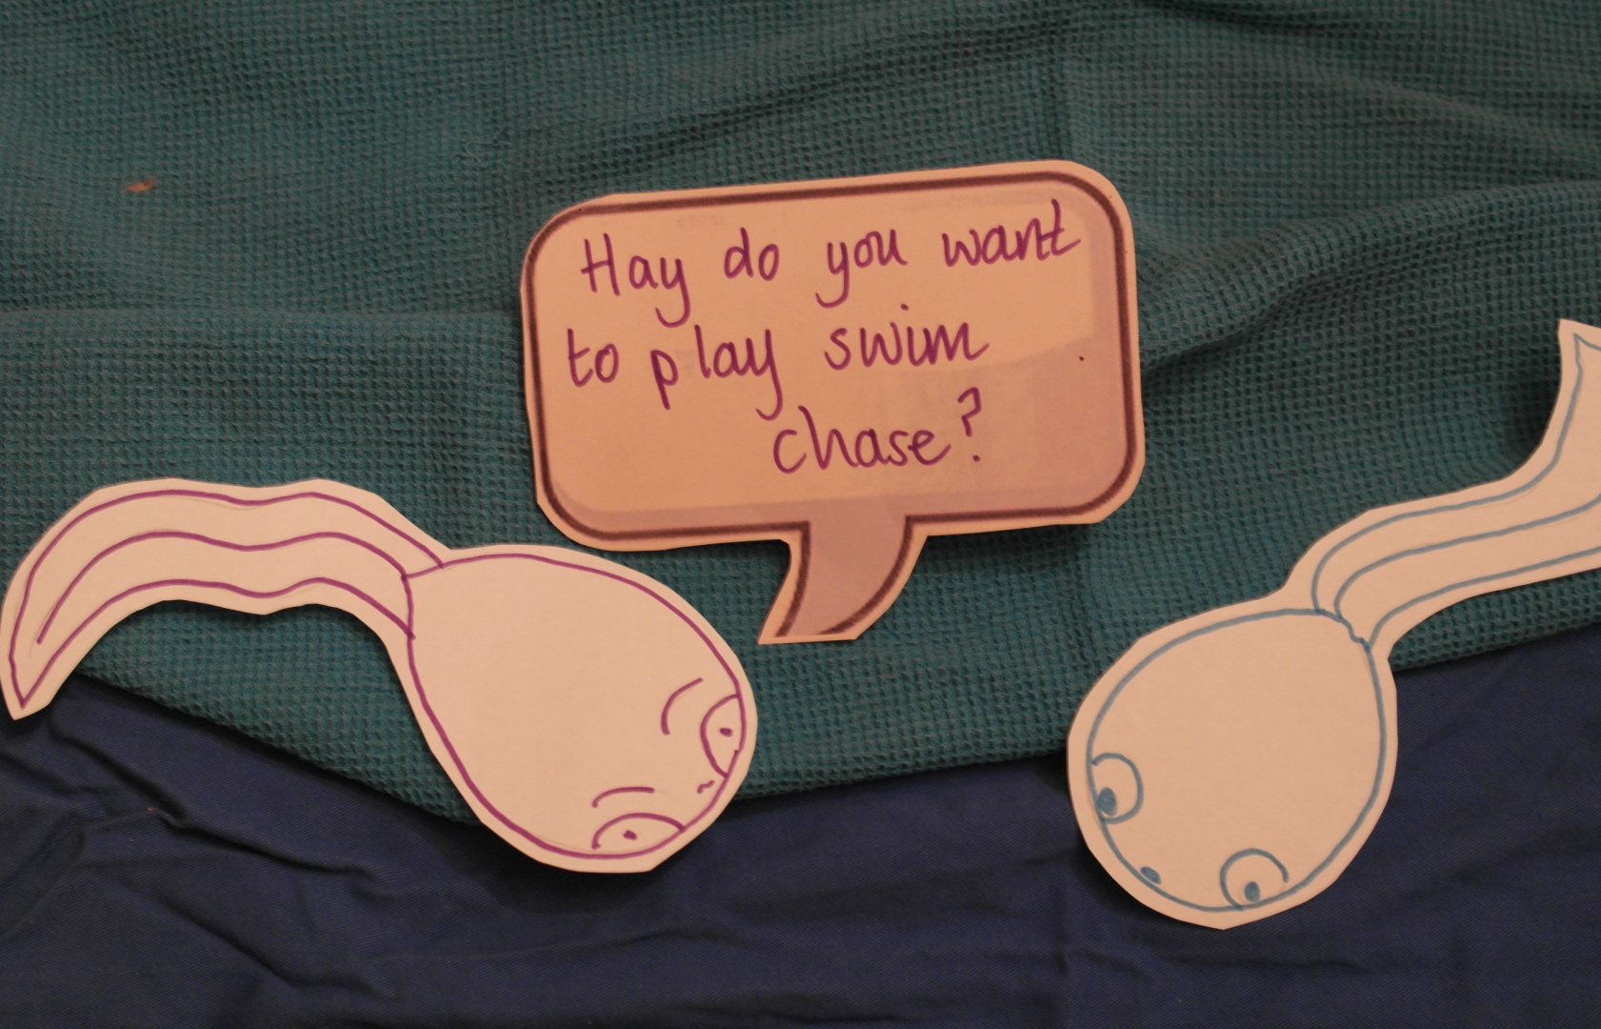
One day the tadpoles Tad and Tod decided to play a game.
Do you want to play swim chase?

Slide 7
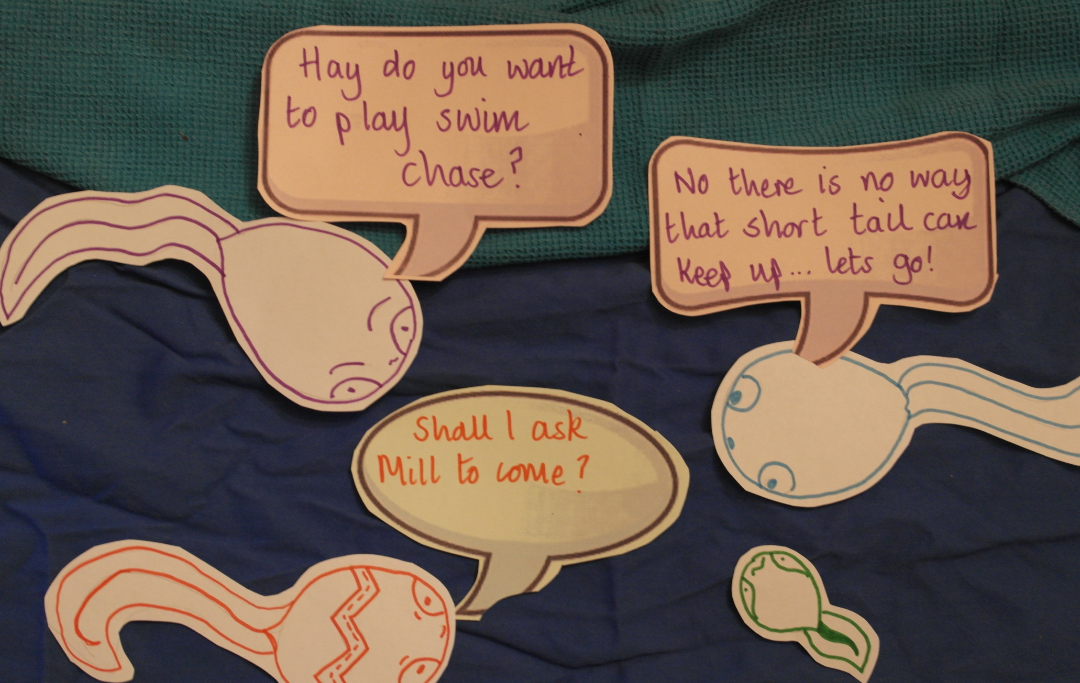
The other tadpoles often left Mill out thinking she could not keep up and play with them. They did not think about what might help her to join in.
Do you want to play swim chase?
No there is no way she can keep up…let’s go!
Shall I ask
Mill to come?

Slide 8
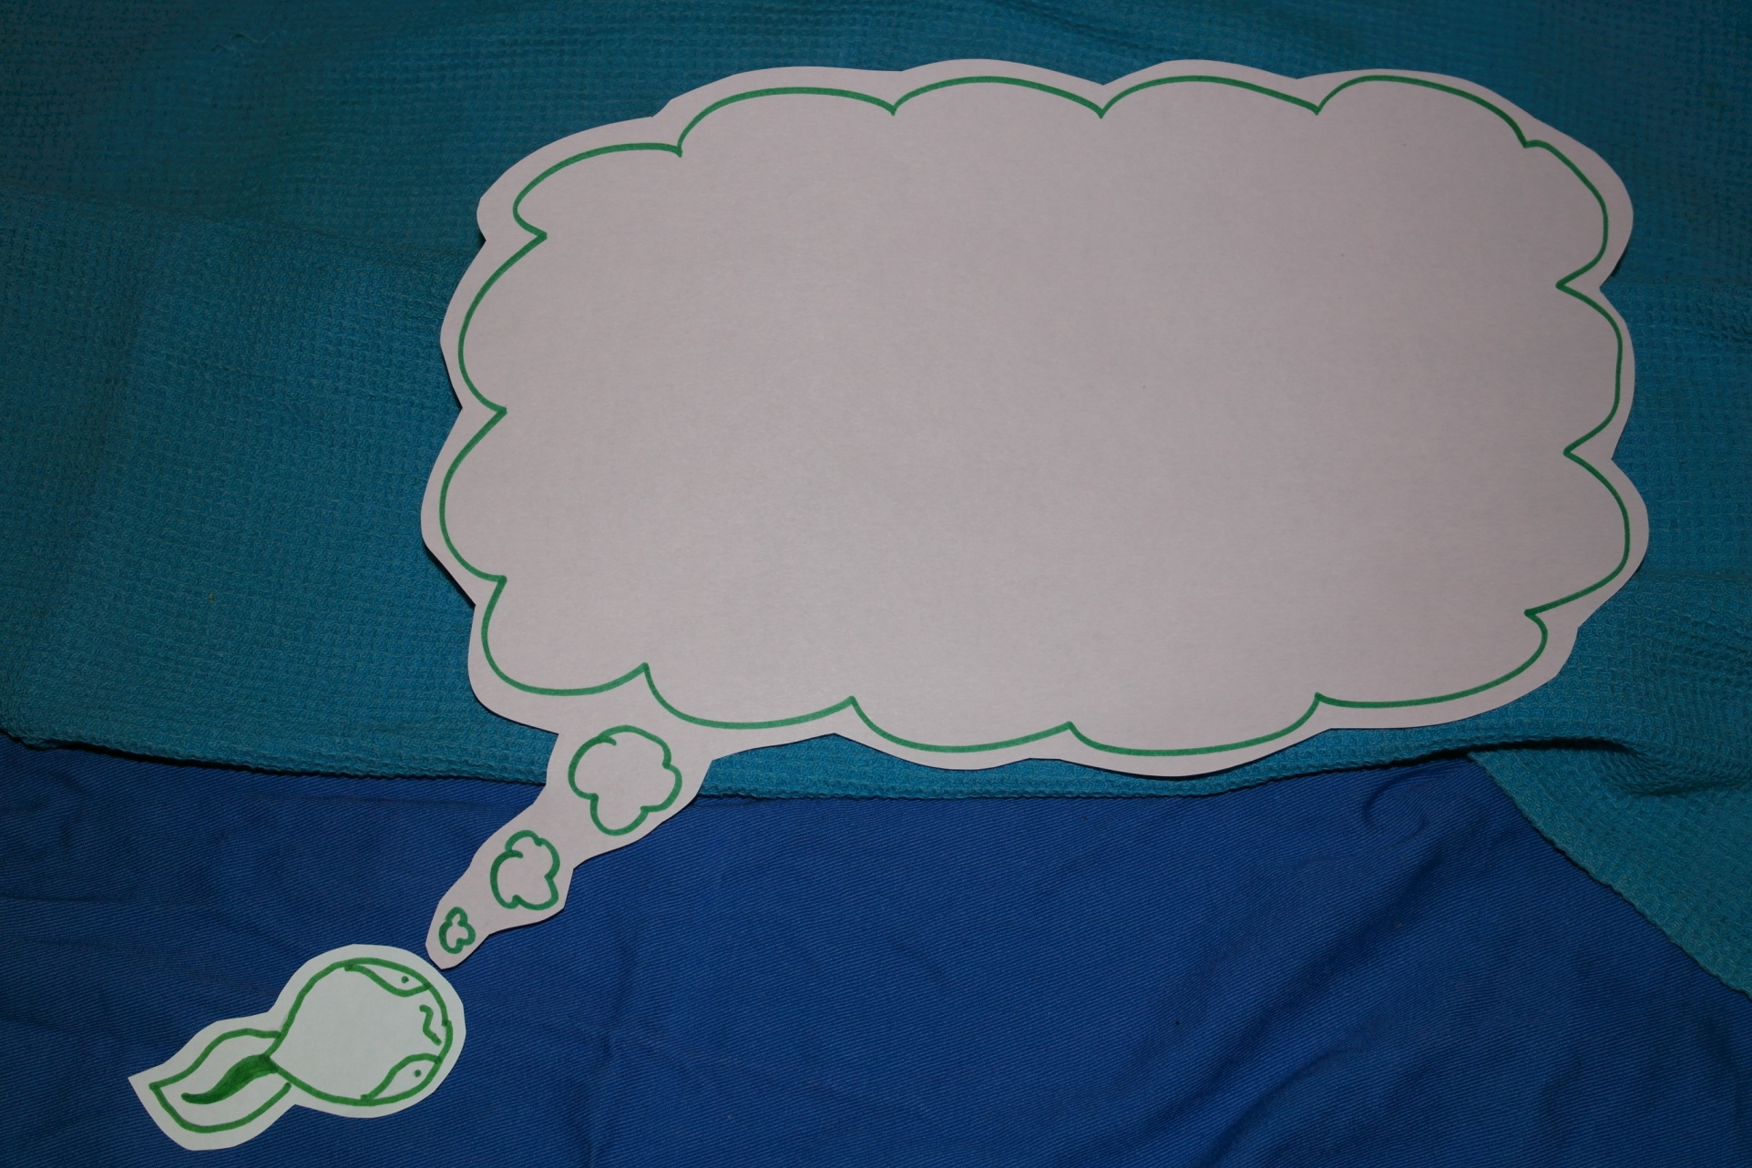
How do you think Mill is feeling?

Slide 9
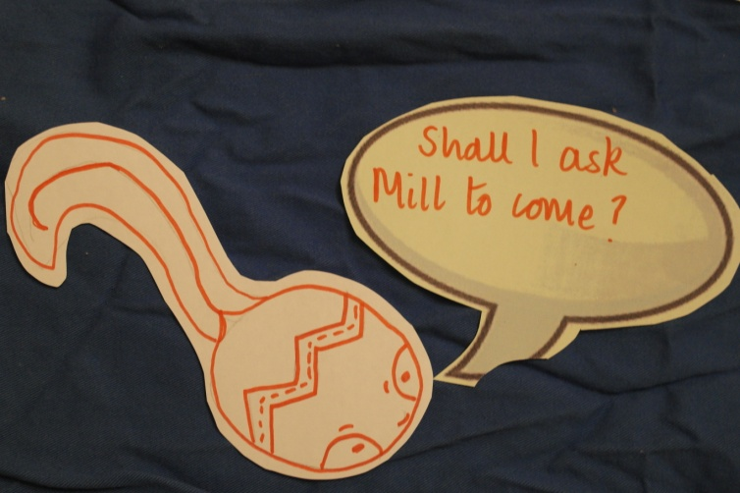
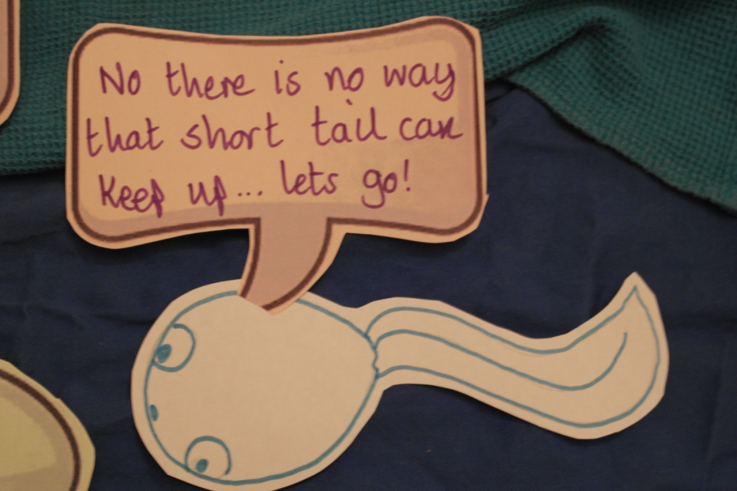
Each day the tadpoles grew and each day they tried a new adventure. Each day Zig-Zag asked if Mill could join in. Each day the answer was no!

Slide 10
Mill quietly swam away and practiced her unique way of swimming on her own.

Slide 11
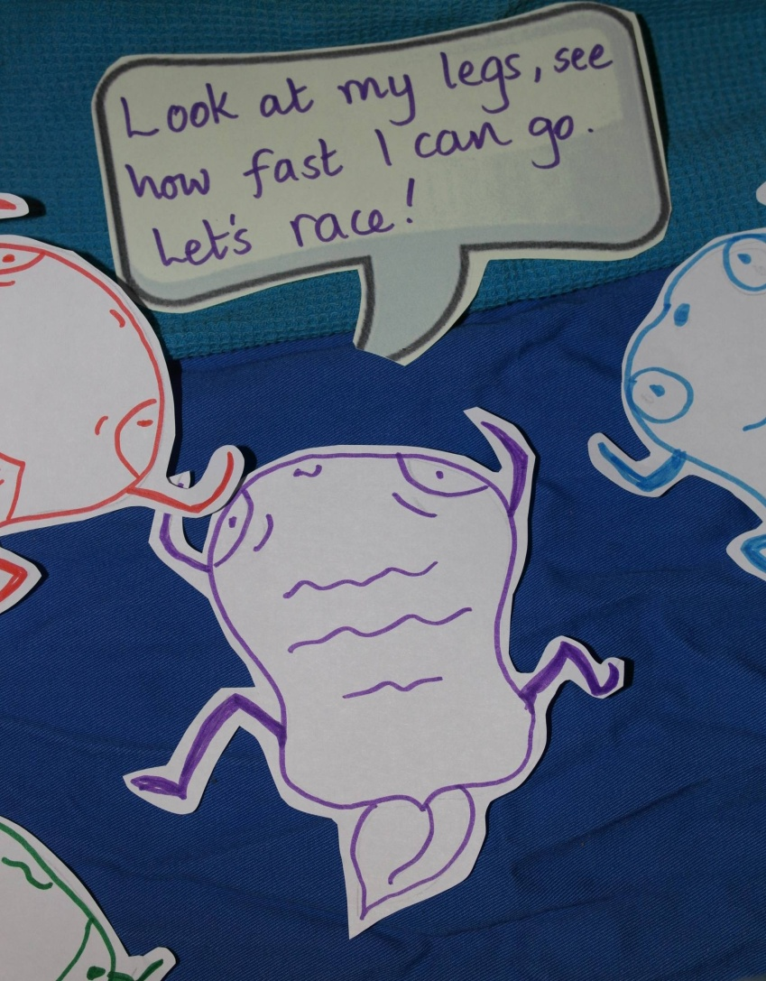
As time went by the little tadpole grew and grew. They started to change. Their tails shrank and strong, powerful legs began to grow.

Slide 12
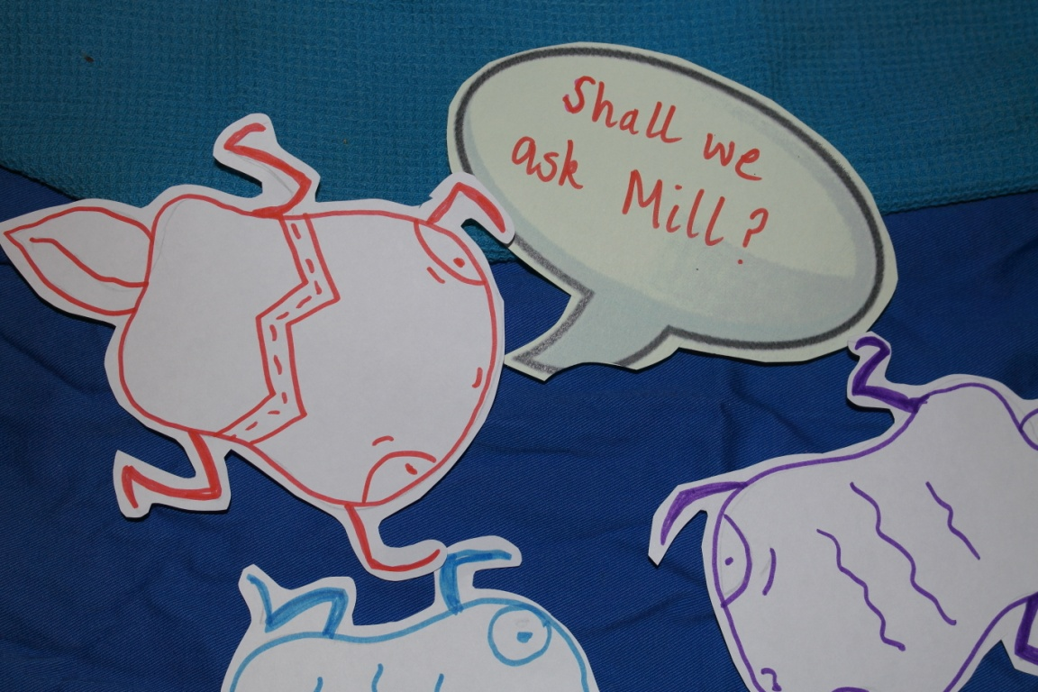
It did not take long before the other little frogs started to explore their surroundings.
Each time ZigZag asked if Mill could come and each time they said ‘NO!’

Slide 13
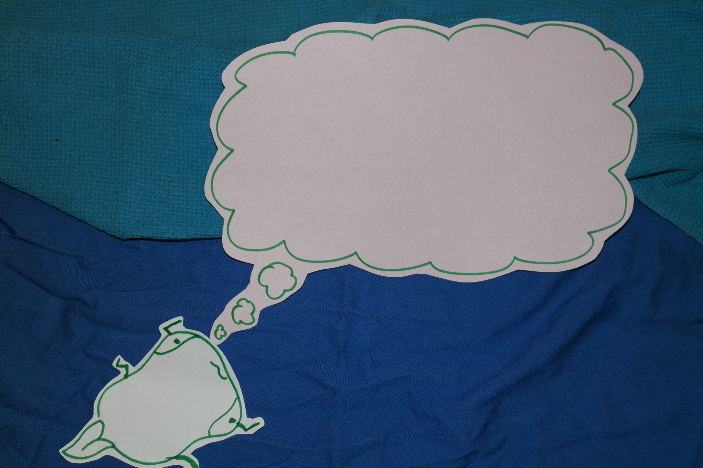
How do you think Mill is feeling now?

Slide 14
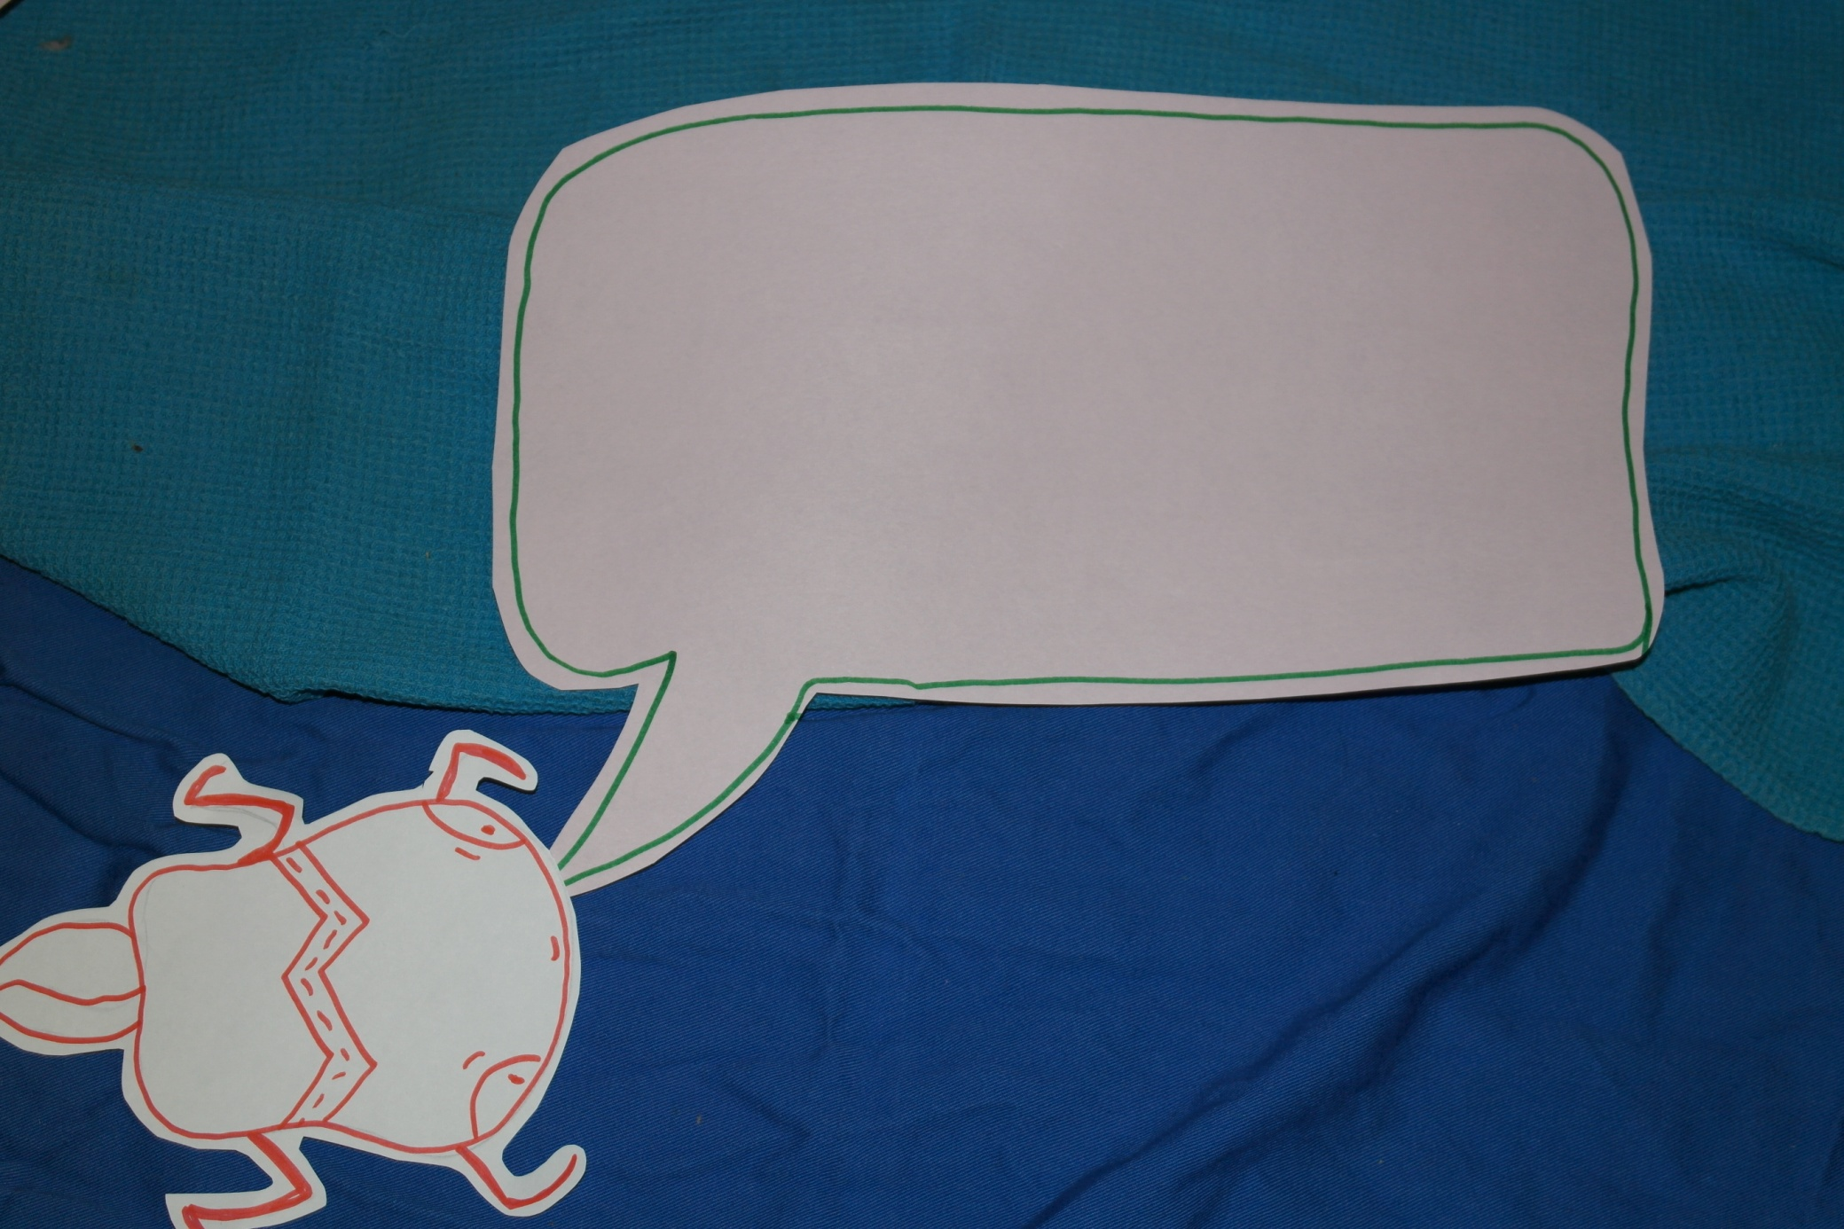
What should Zig-Zag do?

Slide 15
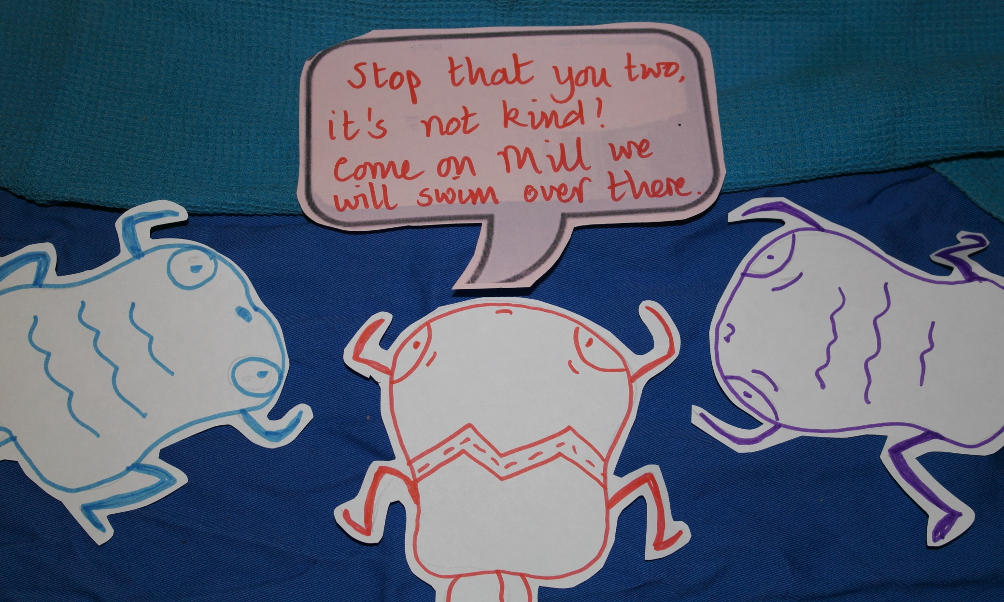
Zig-Zag could not listen to the other frogs being mean to Mill any more. She knew what she had to do. She took a deep breath and bravely told Tad and Tod to stop being so unkind.

Slide 16
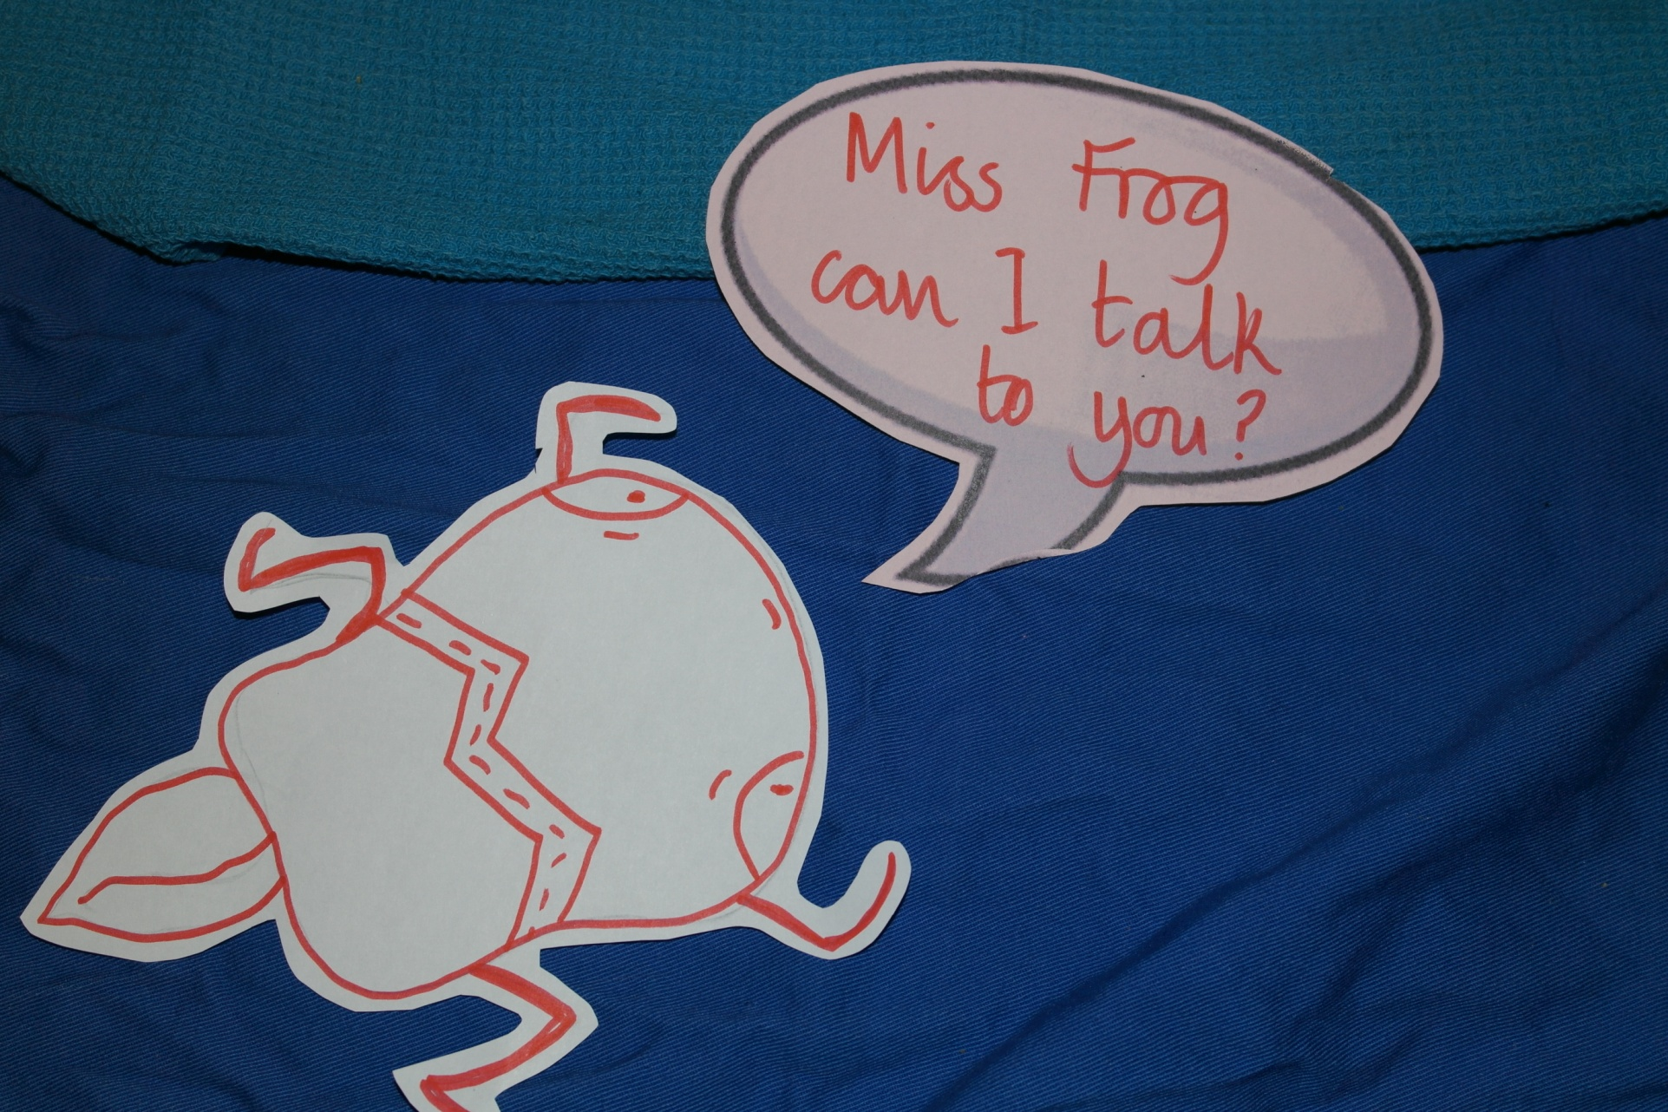
Then she swam away back to Frog school she knew she had to tell a grown up what had been going on.

Slide 17
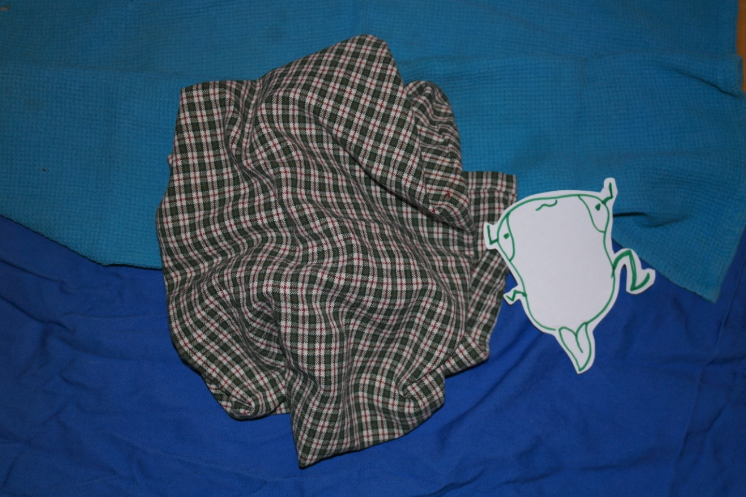
Zig-Zag felt better after she had talked to an adult. She swam off to find her friend Mill to check she was ok.
Zig-Zag joined Mill and they became very good friends.

Slide 18
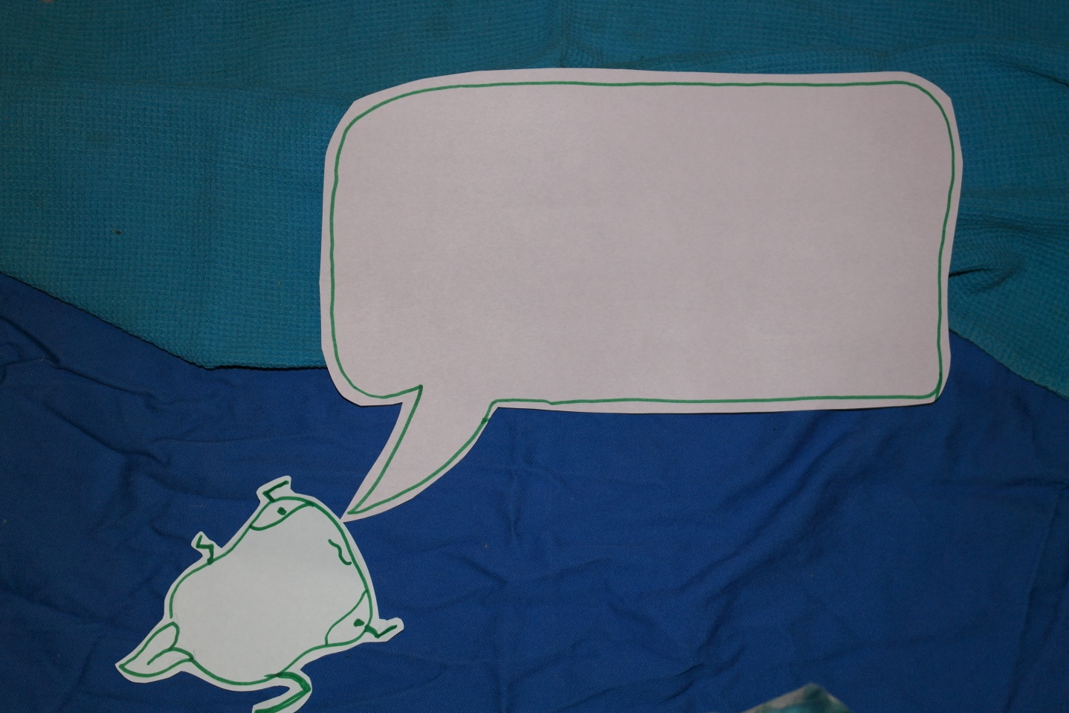
Before long all the little frog noticed that Mills and Zig-Zag were having lots of fun too. One by one they went over to join in – they all had fun together.

Slide 19
Questions
How do you think Mill is feeling now?
What might she want to say to the other little frogs?
What do you think Miss Frog said to Tad and Tod?
What do you think Tad and Tod should do now?

Slide 20
The ‘What If’ Game
Tell an adult
Walk away
Say something
Join in
Notes:
You can play this game in several different ways. The aim of the game is to promote discussion about what is bullying and what to do if you are being bullied, what to do if you see someone being bullied. Bullying is everyone’s responsibility and together we can stop it for ALL!
Either put the pupils in groups to complete this activity or complete it as a whole class.
A small group of pupils should discuss the scenarios in Activity Sheet XXX ‘What should you do if?’ and either:
Ask each young person to fill in activity sheet XXX or
Cut out the cards for each pupil in activity sheet XXX and they can vote after discussion by holding up the card that they agree with the most

Slide 21
What can make people different?
We have all looked at what makes us unique
Sometimes this might be because a person has a disability
A disability is something that might make some aspects of life different. For example understanding, getting around, seeing, hearing, speaking.

Slide 22

Disability
Do you know someone who has a disability?
How does it affect them?

Slide 23

Disability
No, not always.
Just as no two people are the same, no two disabled people are the same.
The way their disability affects them and appears will be different.
Can you always tell if someone is disabled?

Slide 24
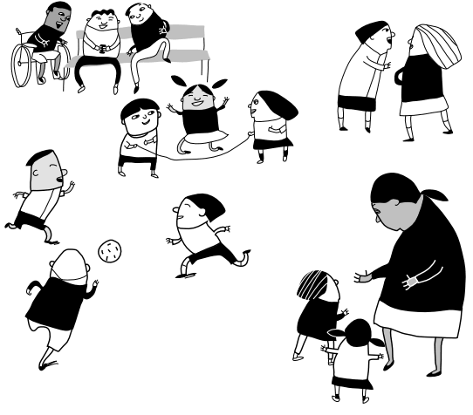
What should be the same is ...
How we treat people
Why is this important?

Slide 25
Our school ethos/charter/pledge
Everyone is included in our school.
What do we mean by this?

Slide 26
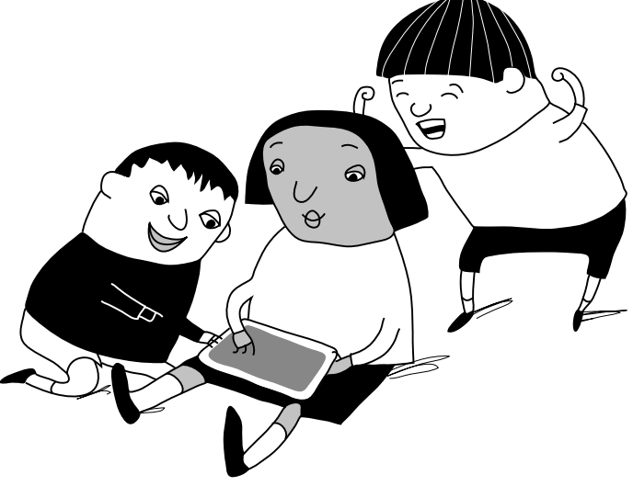
What can we do?
In our class, how can we make sure that everyone is included?
In our class how can we make sure that children are not bullied?

Slide 27

Let’s support Ant-Bullying Week 2014:

